Slide 1
Development of a Sports Analytics Platform for Rugby
Presented by Steven Nolan

Slide 2


Aims and Objectives
Research on publicly available rugby data and web scraping.
Exploration of data analysis techniques and machine learning.
Focus on security methods for data integrity.

Slide 3


Research and Investigation
The Goals of my research
The key techniques to complete this project
Web scraping
Data analysis
Machine learning
The main dataset I plan to use is
The URC 24/25 season

Slide 4


Features this application will contain
Upcoming Games and Fixtures
Head-To-Head Previous Results
Current Table Standings
Team Sheet
Transfer News
Statical analysis
Possession Percentages
Match Stats
Injury Reports
Team Performance Stats
Scoring Patterns
Data Visualization (graphs, heat maps)

Slide 5
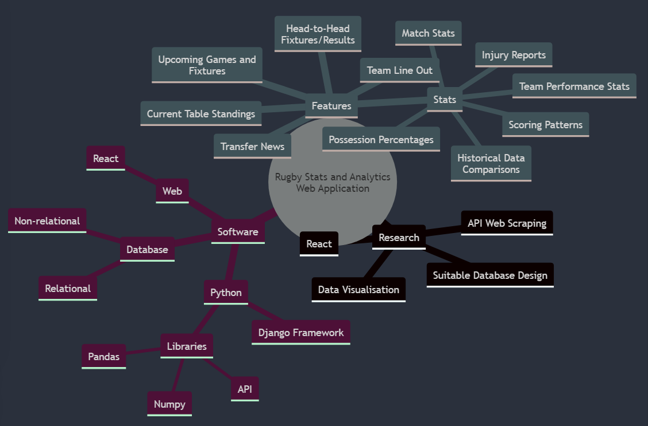
Mind Map

Slide 6

Plan of Work
Research Phase: 2-3 weeks on existing tools, web scraping techniques, and frameworks
Development Phase: Agile methodology, breaking development into sprints with specific goals.
Present progress to my supervisor after each sprint for feedback

